Slide 1
R PROGRAMMING(ELECTIVE)
Dr.S.REVATHY
ASSOCIATE PROFESSOR
DEPARTMENT OF INFORMATION TECHNOLOGY
SATHYABAMA INSTITUTE OF SCIENCE AND TECHNOLOGY

Slide 2
Syllabus
Unit – I
Introduction to R - History and fundamentals of R, Installation and use of R / R Studio / R Shiny, Installing R packages, R – Nuts and Bolts -Getting Data In and Out - Control Structures and Functions- Loop Functions-Data Manipulation- String Operations- Matrix Operations.
Unit – II
R Data interfaces - CSV Files, XML files, Web Data- Data Preprocessing: Missing Values, Principle Component Analysis - Data Visualization – Charts & Graphs-Pie Chart, Bar Chart, Box plot, Histogram, Line graph, Scatter Plot.
Unit – III
Statistical Modeling in R - Descriptive statistics-R Packages: Regression (MASS package) - Distribution (STATS package) - ANOVA - Time Series Analysis.
Unit – IV
Machine Learning in R - Classification: Decision Trees, Random Forest, SVM – Clustering - Association Rule Mining - Outlier Detection.
Unit-V
Overview of R Shiny - R Hadoop - Case Study - Hypothesis Generation, Importing Data set and Basic Data Exploration, Feature Engineering, Model Building.

Slide 3
COURSE OUTCOMES
CO1: Install R Packages and develop applications.
CO2: Demonstrate Data Preprocessing Algorithms and Visualization methods on data-sets in R.
CO3: Apply the Statistical Models in R.
CO4: Demonstrate Machine Learning Algorithms in R.
CO5: Create applications in R Frameworks.
CO6: Develop Engineering Models for Hypothesis Generation and Data Extraction.

Slide 4
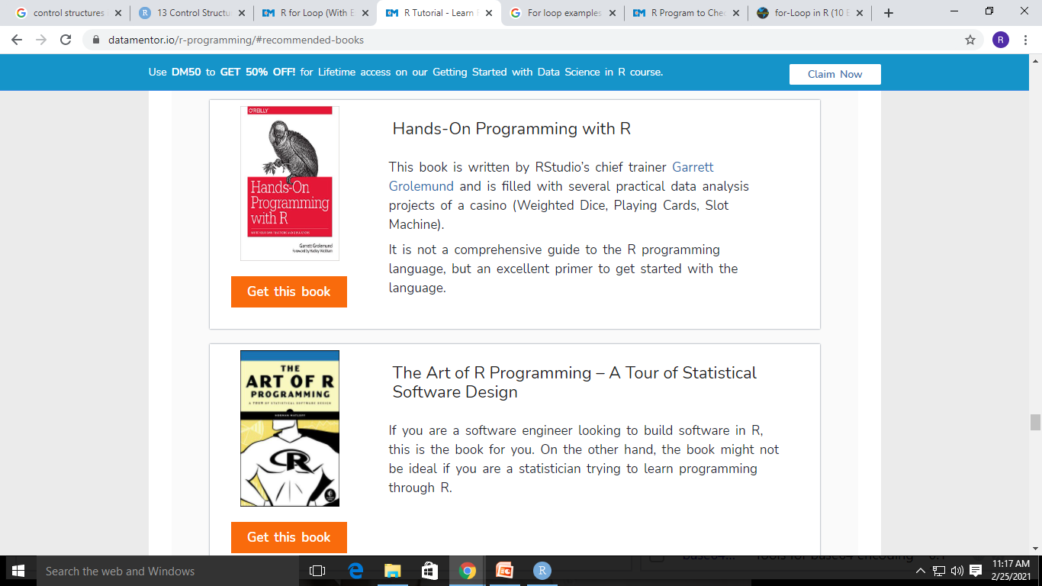
Recommended Books

Slide 5
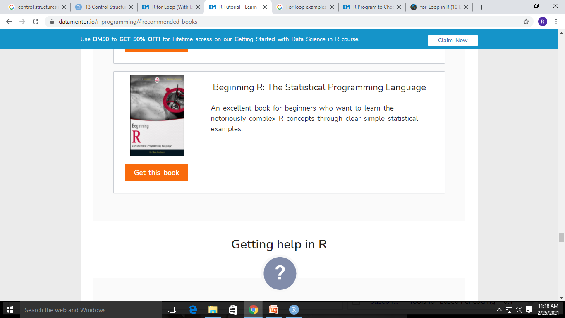
Recommended Books

Slide 6
Useful Links
https://statisticsglobe.com/r-programming-language
https://www.datamentor.io/r-programming

Slide 7
INTRODUCTION TO R
R is the programming language developed by Ross Ihaka and Robert Gentleman in 1993.
R is used in Statistics ,Data Analysis and Machine Learning Algorithms.
R is free Open Source Software.

Slide 8
Features of R
R provides support for both procedural programming and object oriented programming
R can be integrated with other Programming Languages like C,C++ ,Java ,Python etc..
R is capable of effective data handling and storage.
R has more than 10,000 packages in its repository.

Slide 9
Applications of R
Fraud detection especially in Finance and Banking sectors.
Social media analysis to discover potential customers in online advertising.
Healthcare to perform pre-clinical trials and analyze the drug discovery data.
E-Commerce Companies to analyze the purchases made by the customers.

Slide 10
Features of R
R is cross platform compatible
R facilitates complex operations using vectors, Arrays and Data Frames.
R has more community support.

Slide 11
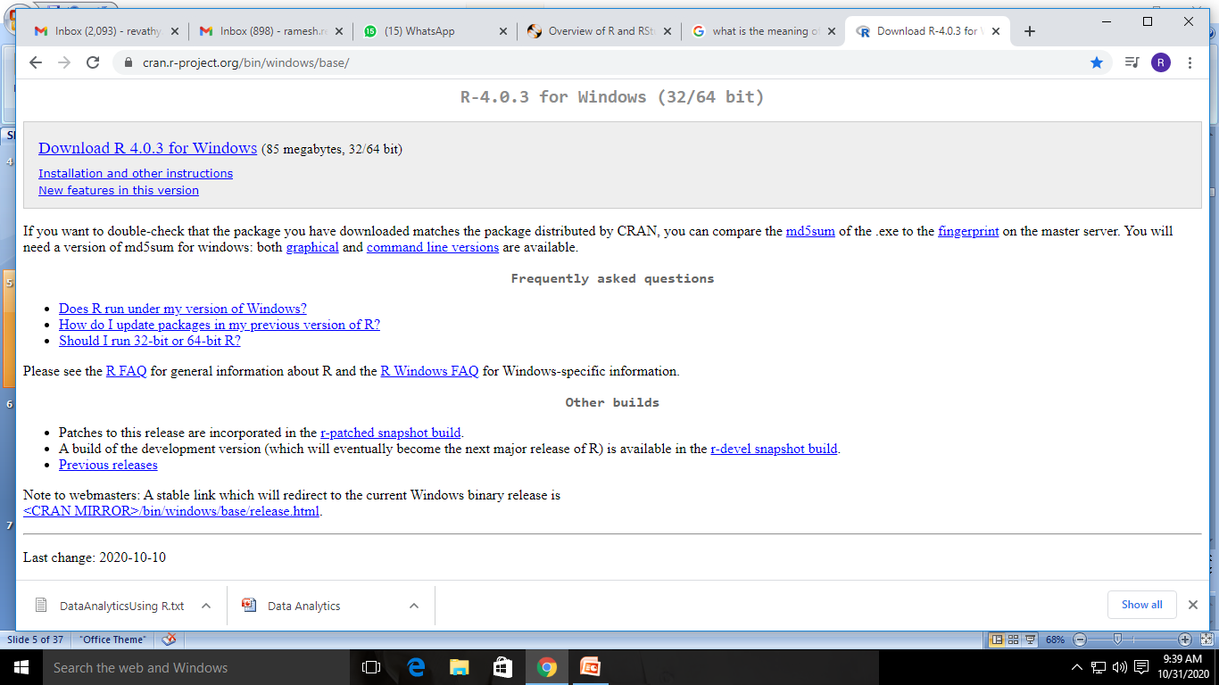
INSTALL R

Slide 12
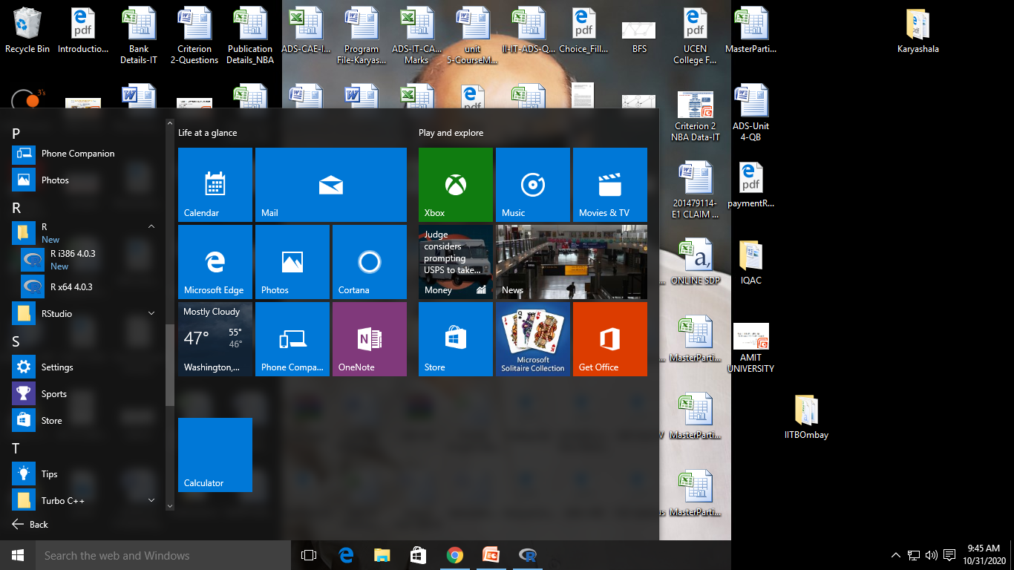

Slide 13
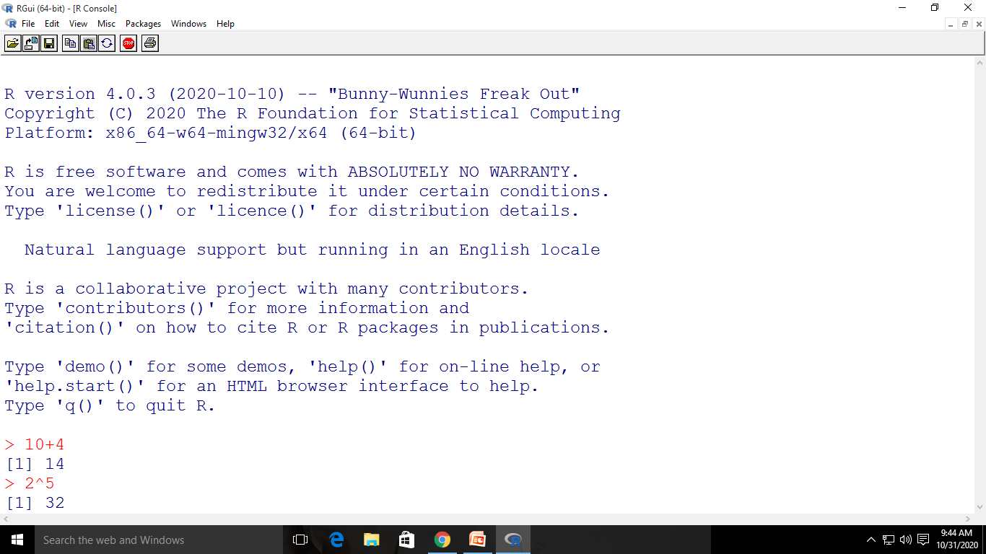

Slide 14
R-STUDIO
R STUDIO is an integrated deveoplment environment for R
It includes console and editor.
It provides tools for plotting ,debugging and workspace management.

Slide 15
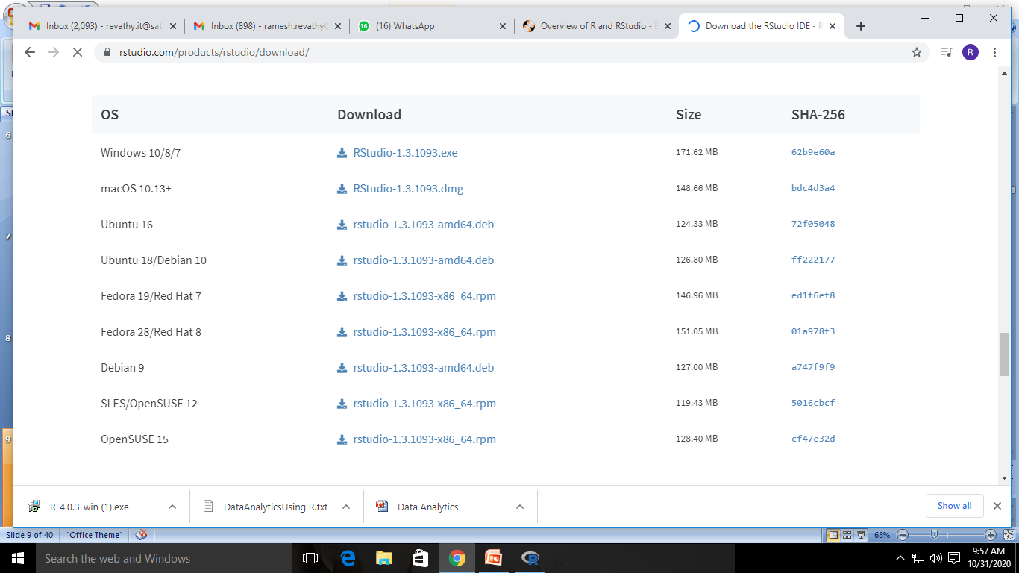
INSTALL R STUDIO

Slide 16
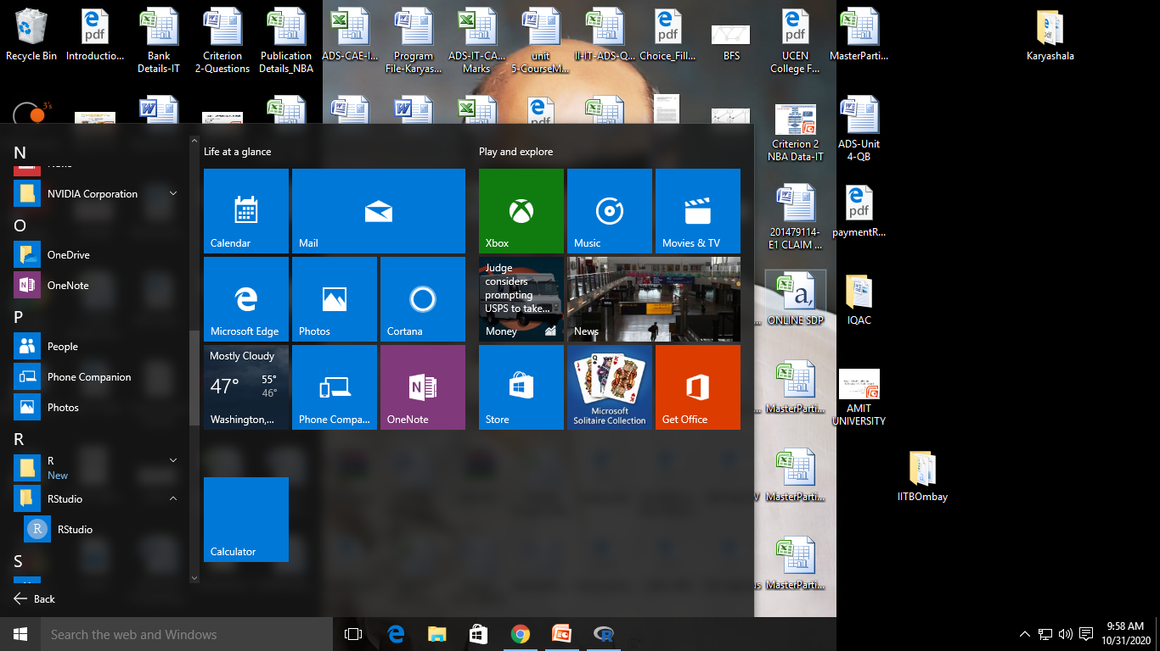

Slide 17
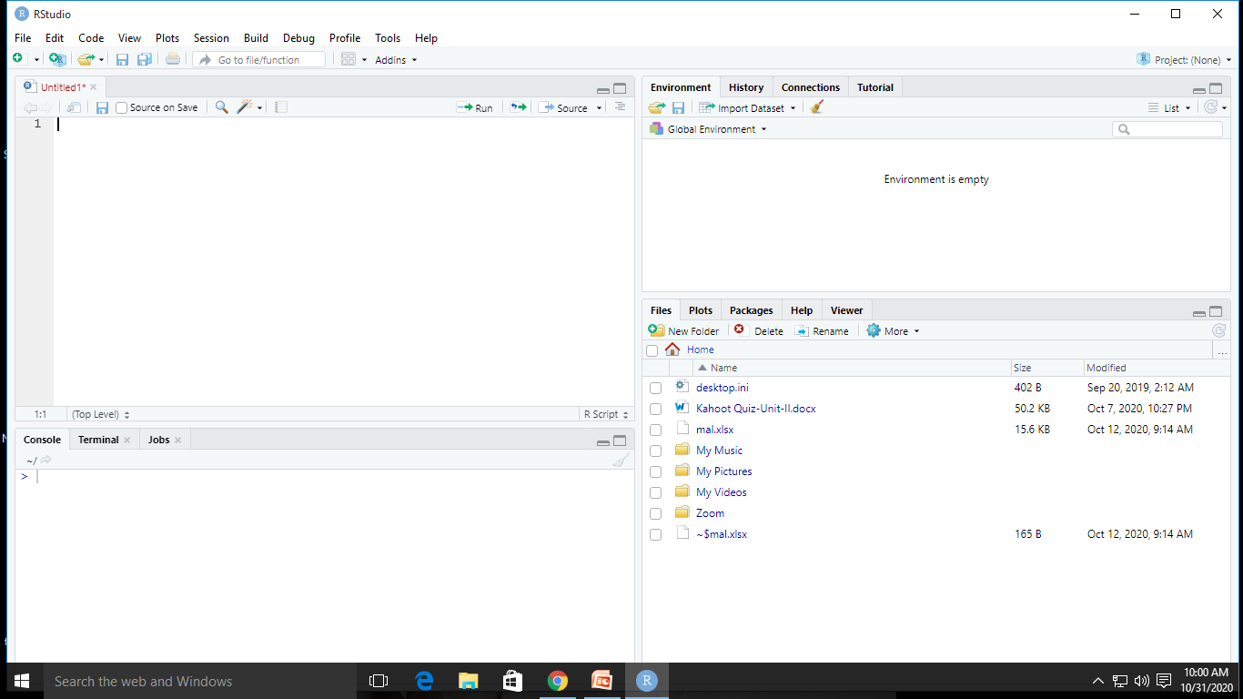

Slide 18
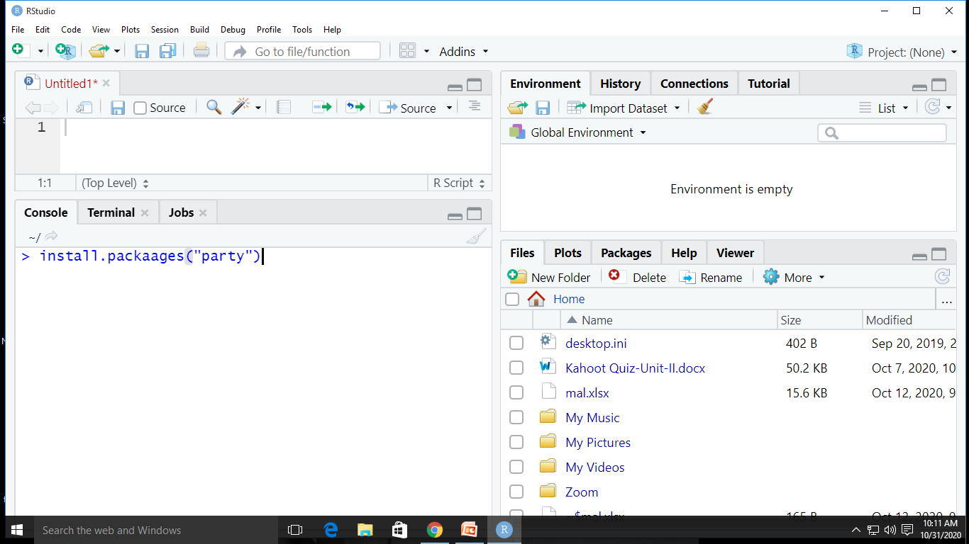
INSTALL PACKAGES IN R

Slide 19
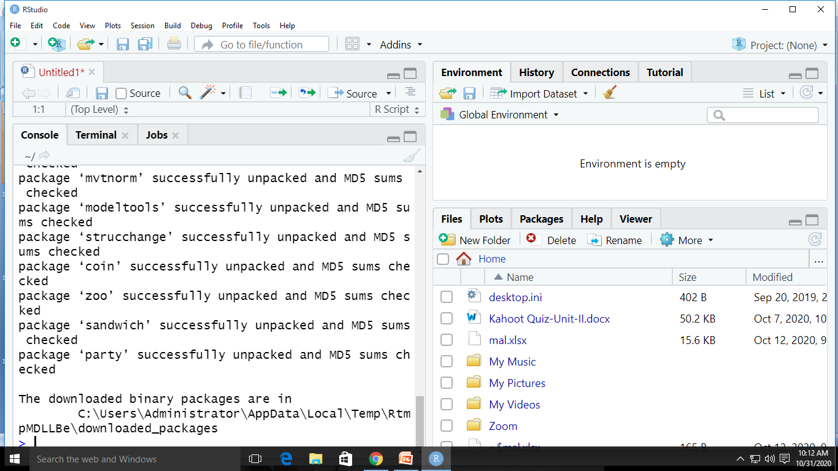

Slide 20
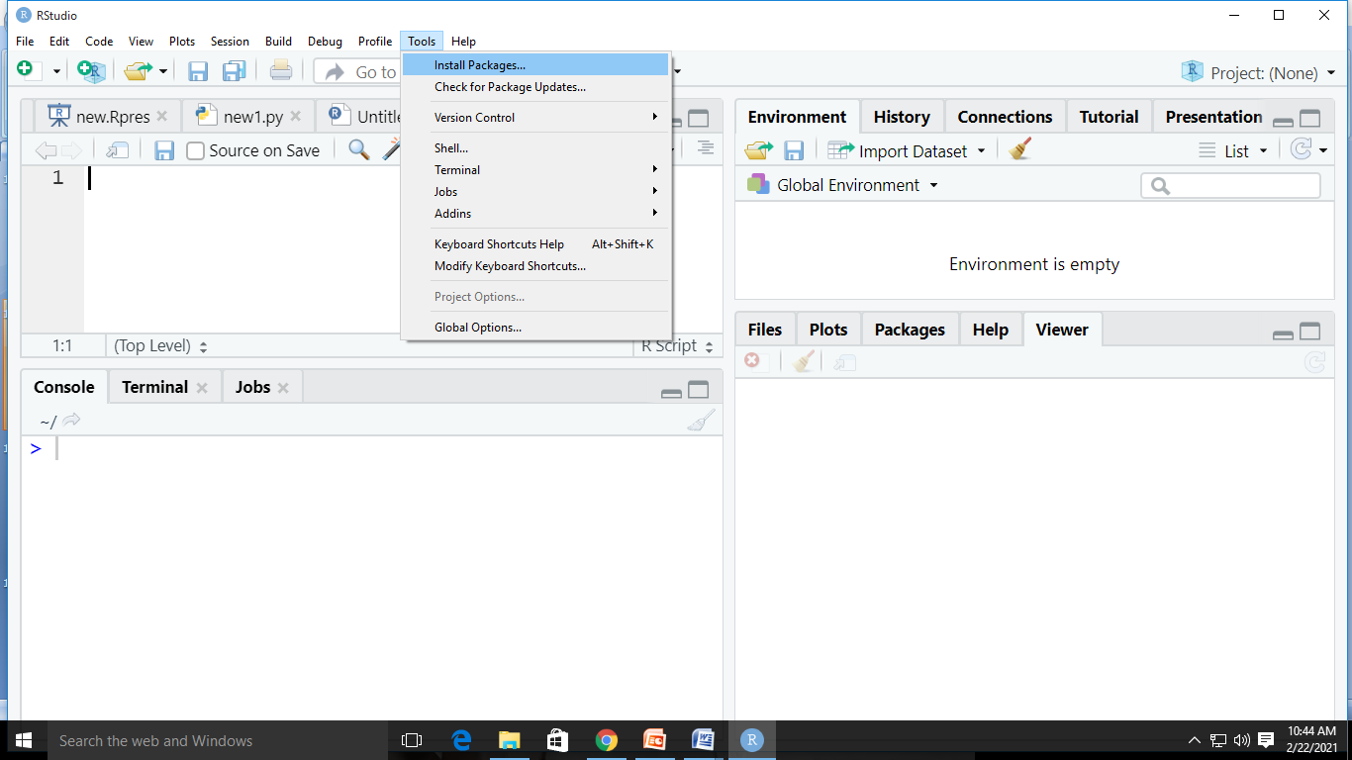
Second Way-Tools-Install Packages

Slide 21
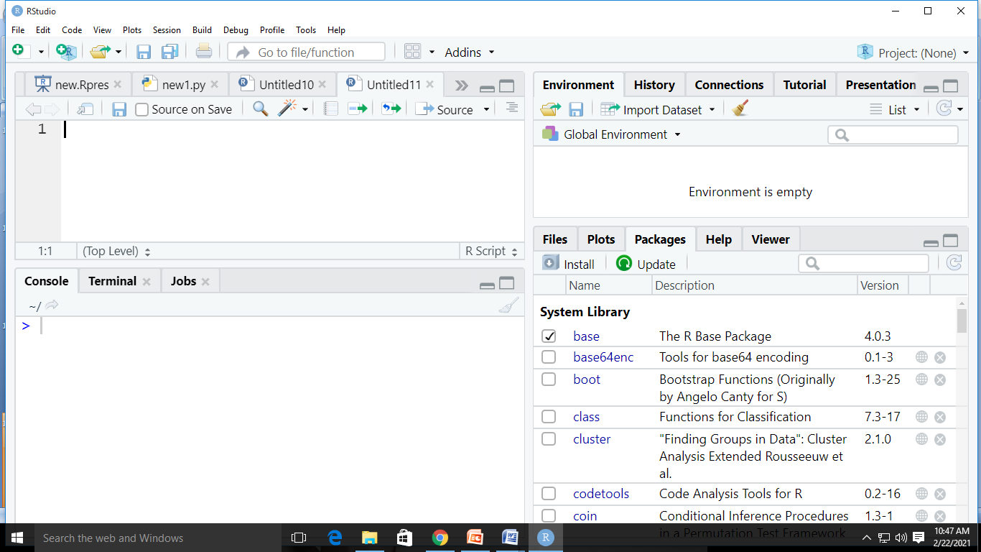
Third Way-Plot Window-Packages-Install

Slide 22
R-Nuts and Bolts
character
numeric (real numbers)
integer
complex
logical (True/False)
Vector
List
Matrix
Data Frame

Slide 23
Data in
read.table, read.csv, for reading tabular data
readLines, for reading lines of a text file
source, for reading in R code files (inverse of dump)
dget, for reading in R code files (inverse of dput)
load, for reading in saved workspaces
unserialize, for reading single R objects in binary form

Slide 24
Data Out
write.table, for writing tabular data to text files (i.e. CSV) or connections
writeLines, for writing character data line-by-line to a file or connection
dump, for dumping a textual representation of single R objects
dput, for outputting a textual representation of multiple R objects
save, for saving an arbitrary number of R objects in binary format (possibly compressed) to a file.
serialize, for converting an R object into a binary format for outputting to a connection (or file).

Slide 25
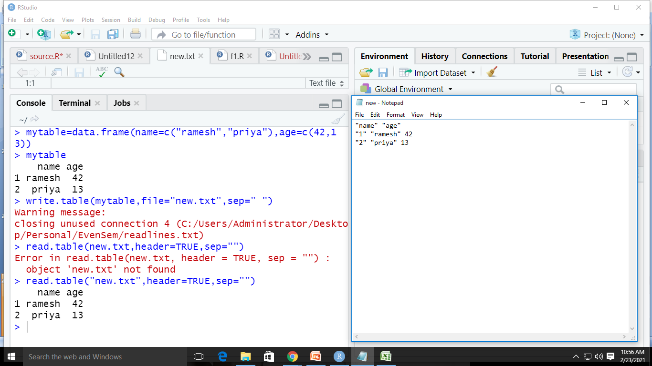
Write.table().read.Table()

Slide 26
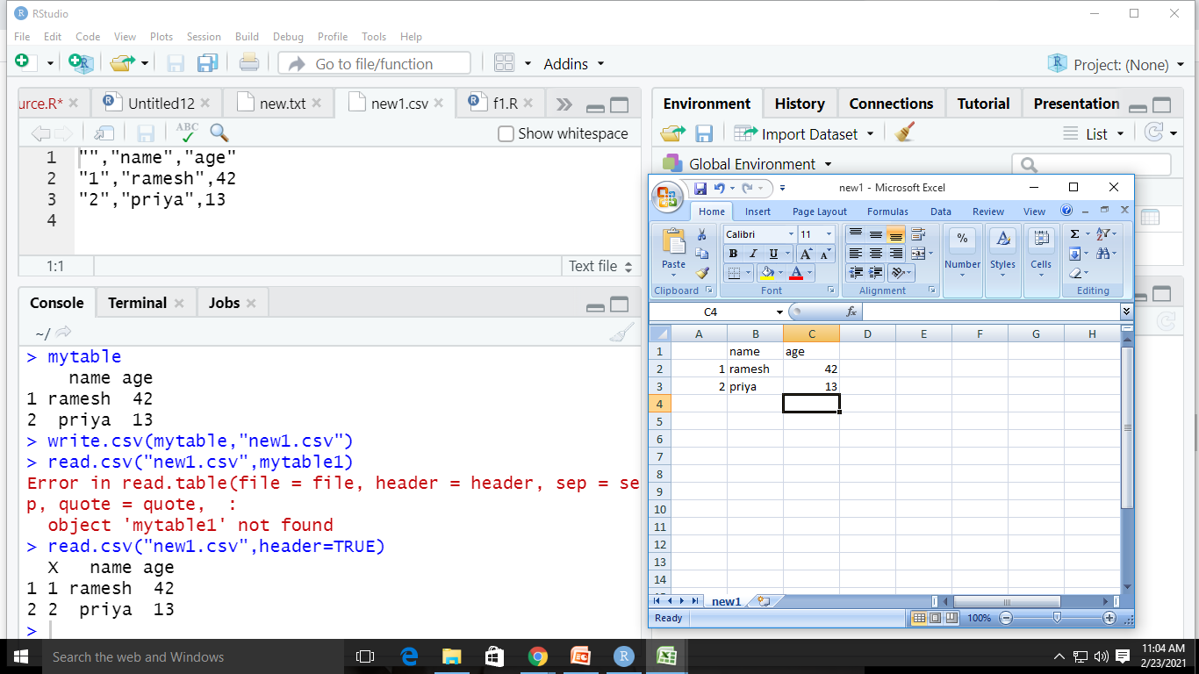
write.csv(),read.csv()

Slide 27
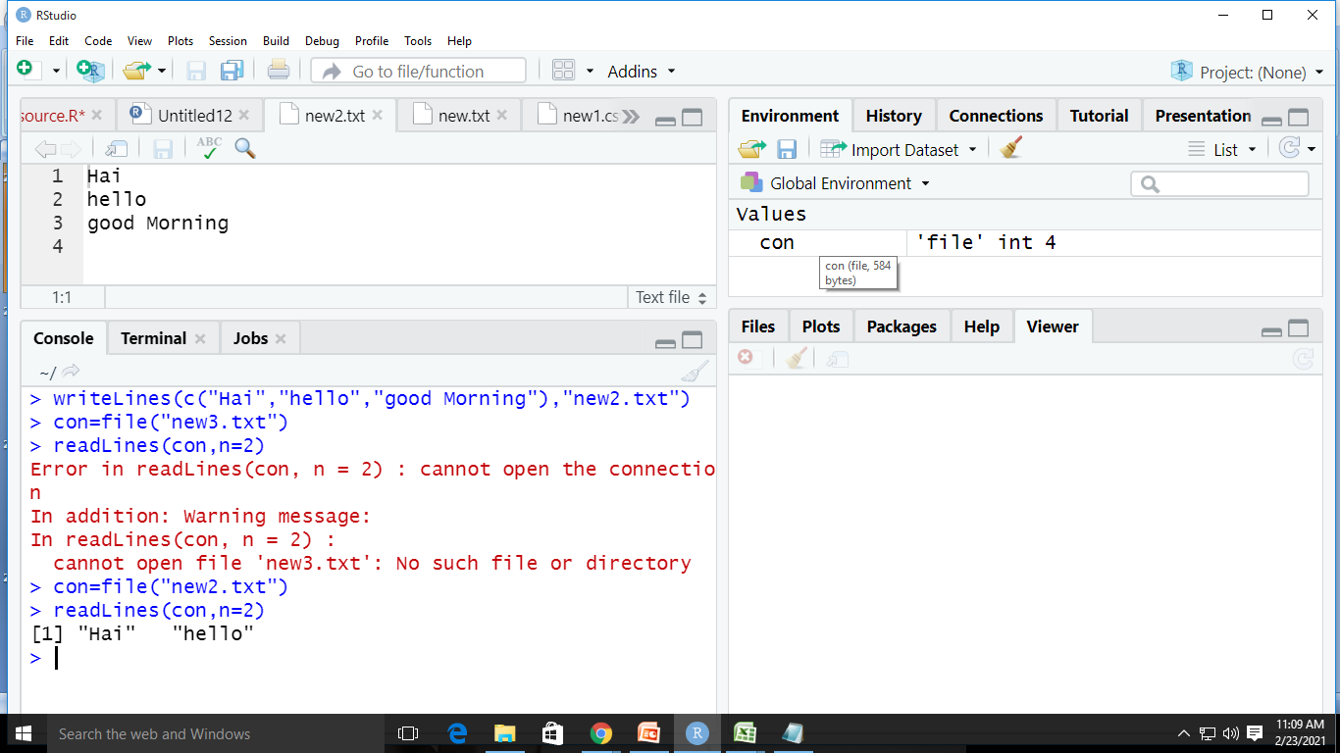
writeLines() and readLines()

Slide 28
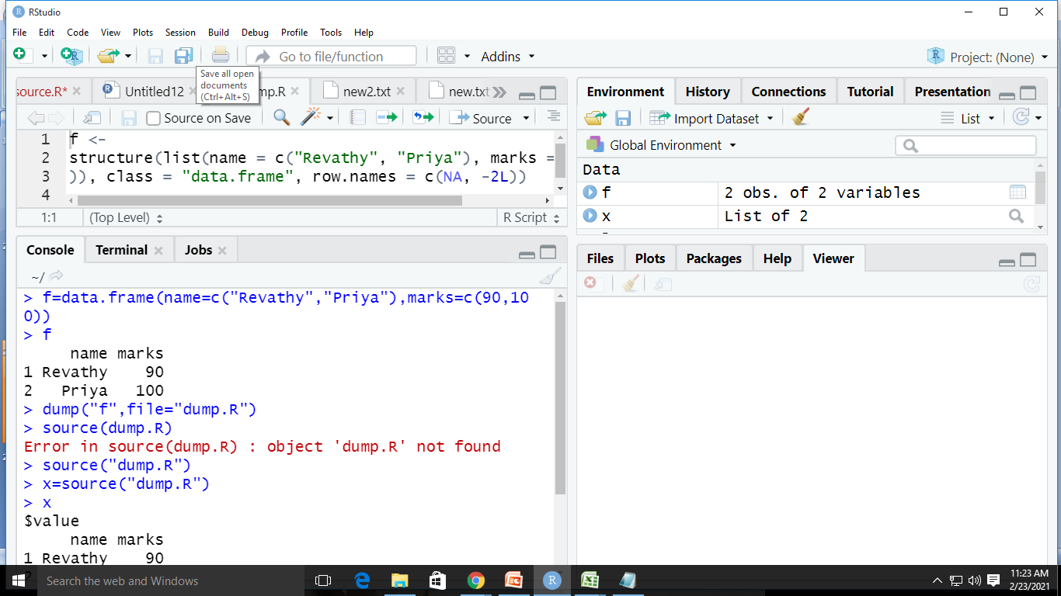
dump() and source()

Slide 29
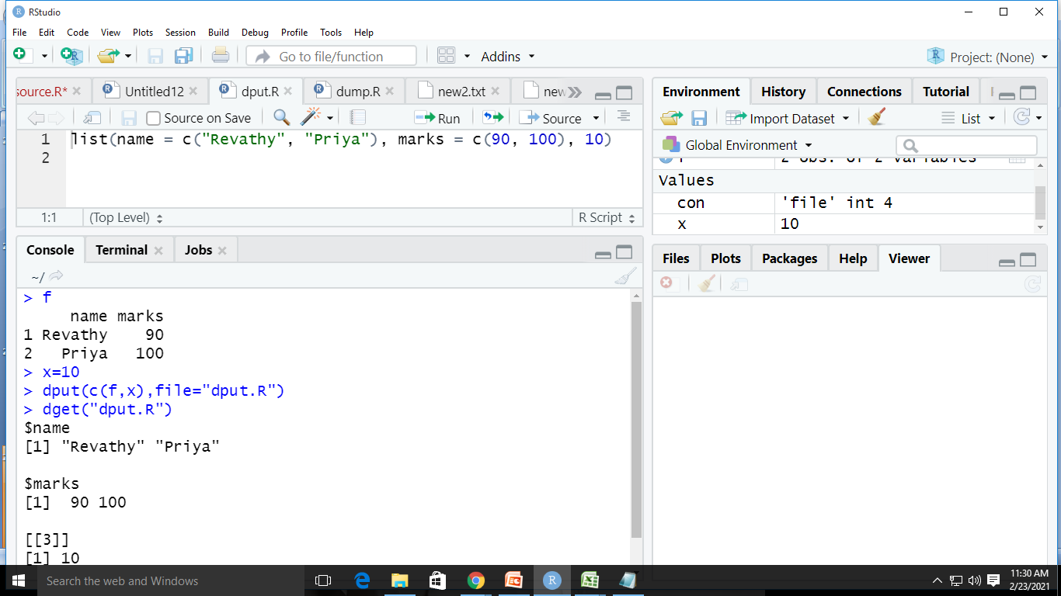
dput() ,dget()

Slide 30
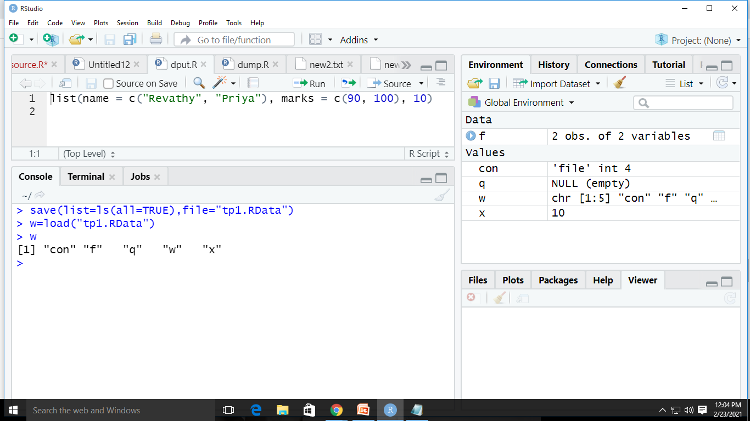
save() and load()

Slide 31
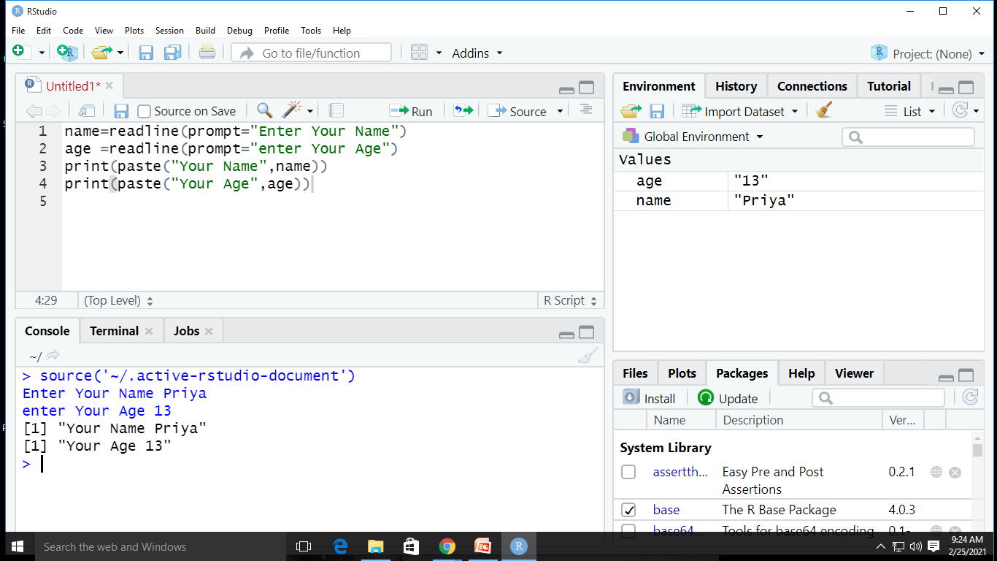
Getting User Input and Display

Slide 32
CONTROL STRUCTURES
Control structures in R allow you to control the flow of execution of a series of R expressions
Commonly used control structures are
if and else: testing a condition and acting on it
for: execute a loop a fixed number of times
while: execute a loop while a condition is true
repeat: execute an infinite loop (must break out of it to stop)
break: break the execution of a loop
next: skip an iteration of a loop

Slide 33
IF -ELSE
Simple IF
IF-ELSEIF LADDER
if(<condition>) { ## do something }
IF-ELSE
if(<condition>) { ## do something } else { ## do something else }
if(<condition1>) {something } else if(<condition2>) { ## do something different } else { ## do something different }

Slide 34
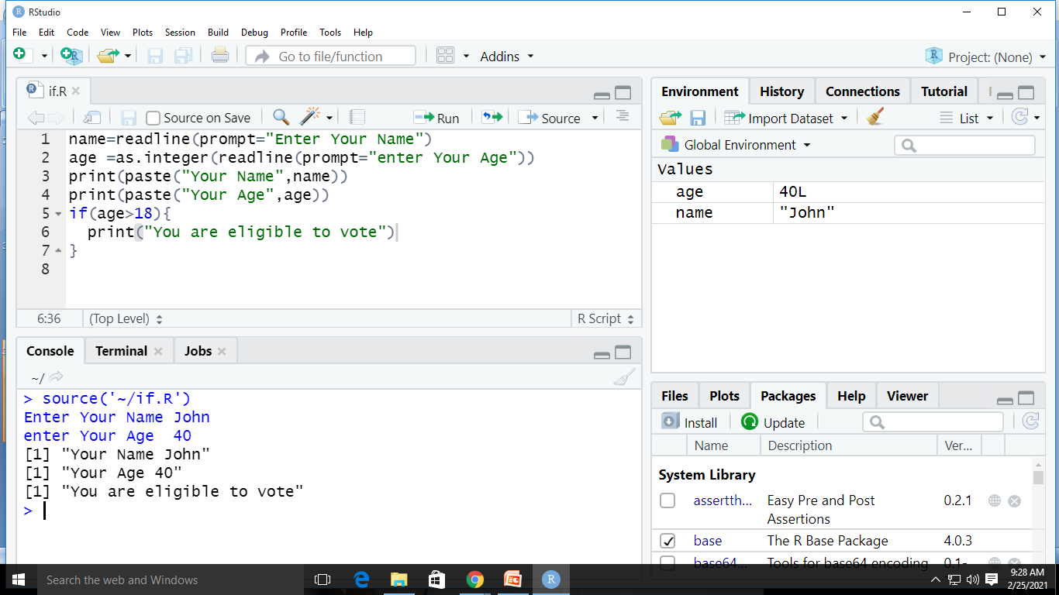
EXAMPLE-IF
SYNTAX
Example
if(<condition>) { ## do something }

Slide 35
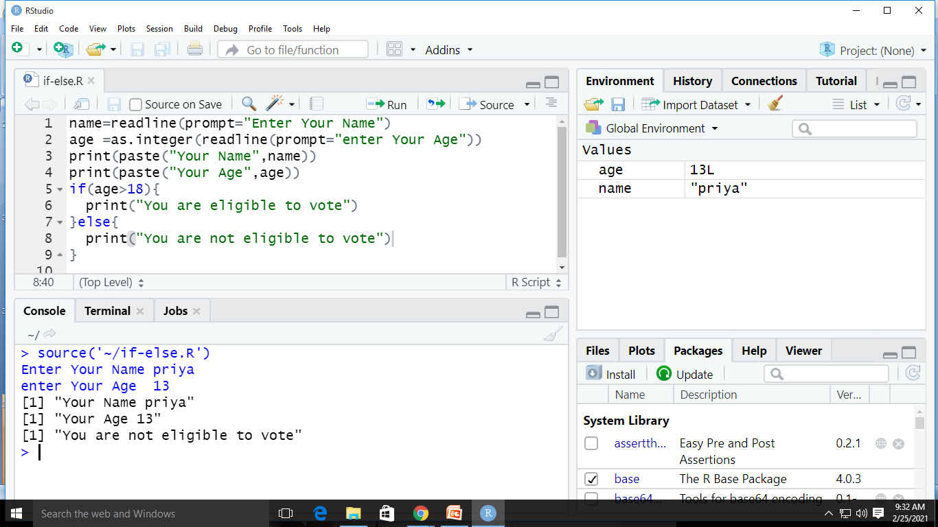
IF-ElSE
Example
Syntax
if(<condition>) { ## do something } else { ## do something else }

Slide 36
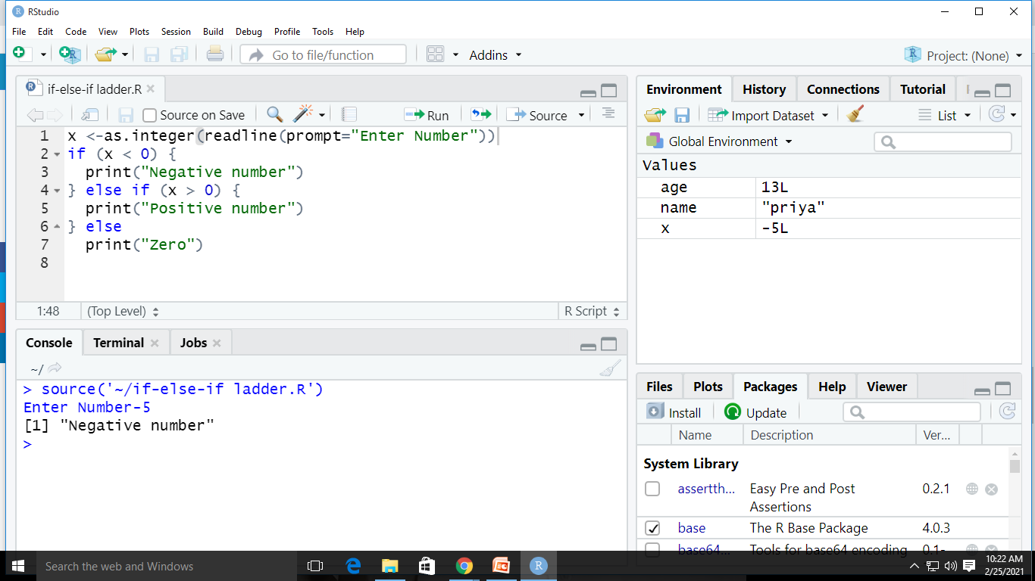
IF-ELSEIF LADDER
SYNTAX
EXAMPLE
if(<condition1>) { something } else if(<condition2>) { ## do something different } else { ## do something different }

Slide 37
EXERCISE
Check if a number is Odd or Even using R Programming.
Write a R program to check for Leap Year.
(Hint :Modulo Operator in R is %%)

Slide 38
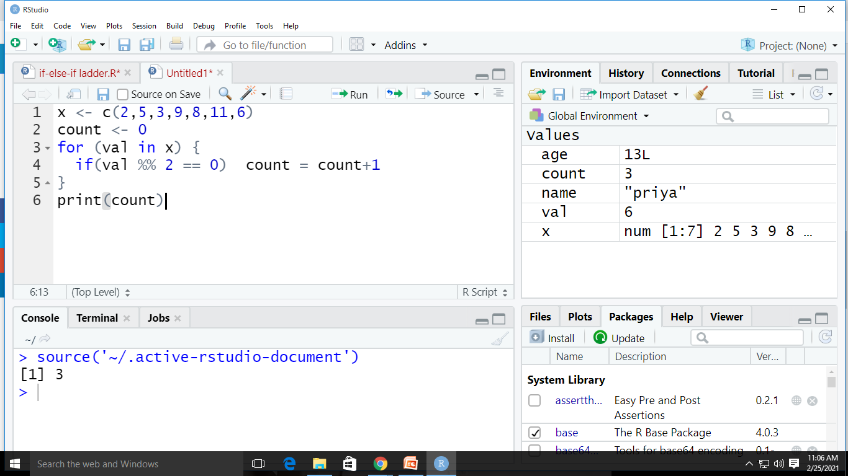
For Loop
Synatx:
for (val in sequence)
{
statement
}

Slide 39
Exercise(For loop)
Write a R Program to find Factorial of Given Number
Write a R Program to check for a Prime Number

Slide 40
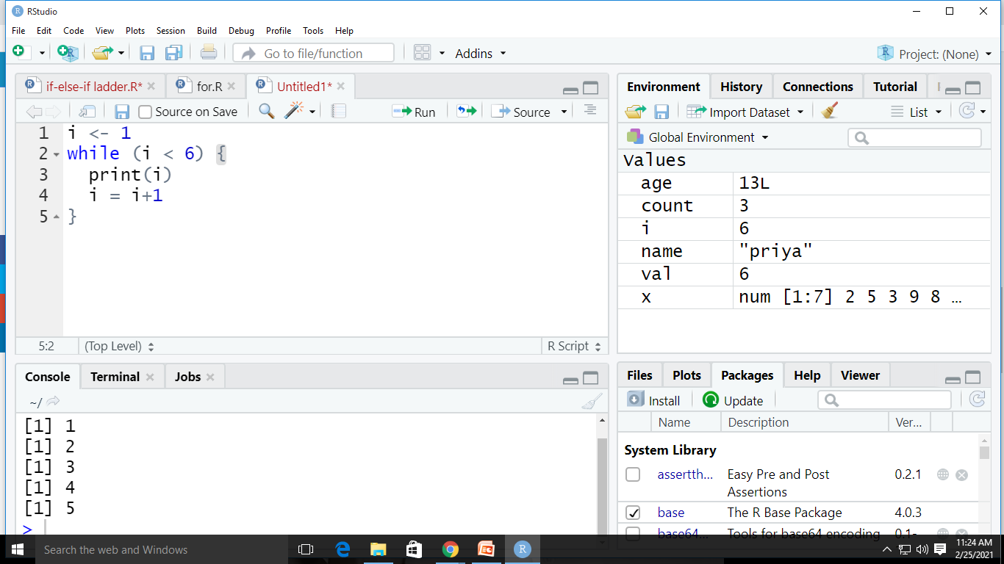
While Loop
while (test_expression) { statement }

Slide 41
Exercise(While)
Write a R program Check Armstrong Number
Write a R Program to Print the Fibonacci Sequence
Write a R Program to find the Sum of Natural Numbers

Slide 42
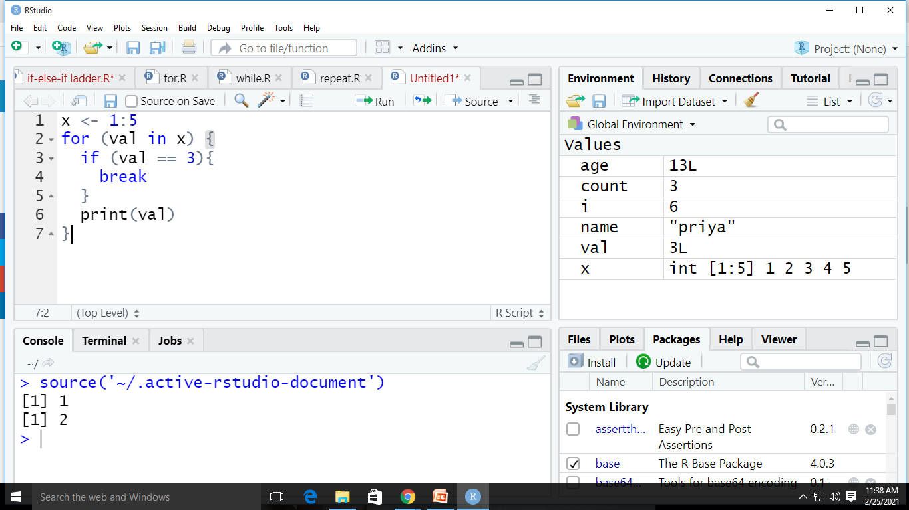
Break
Syntax
Example
if (test_expression) { break }

Slide 43
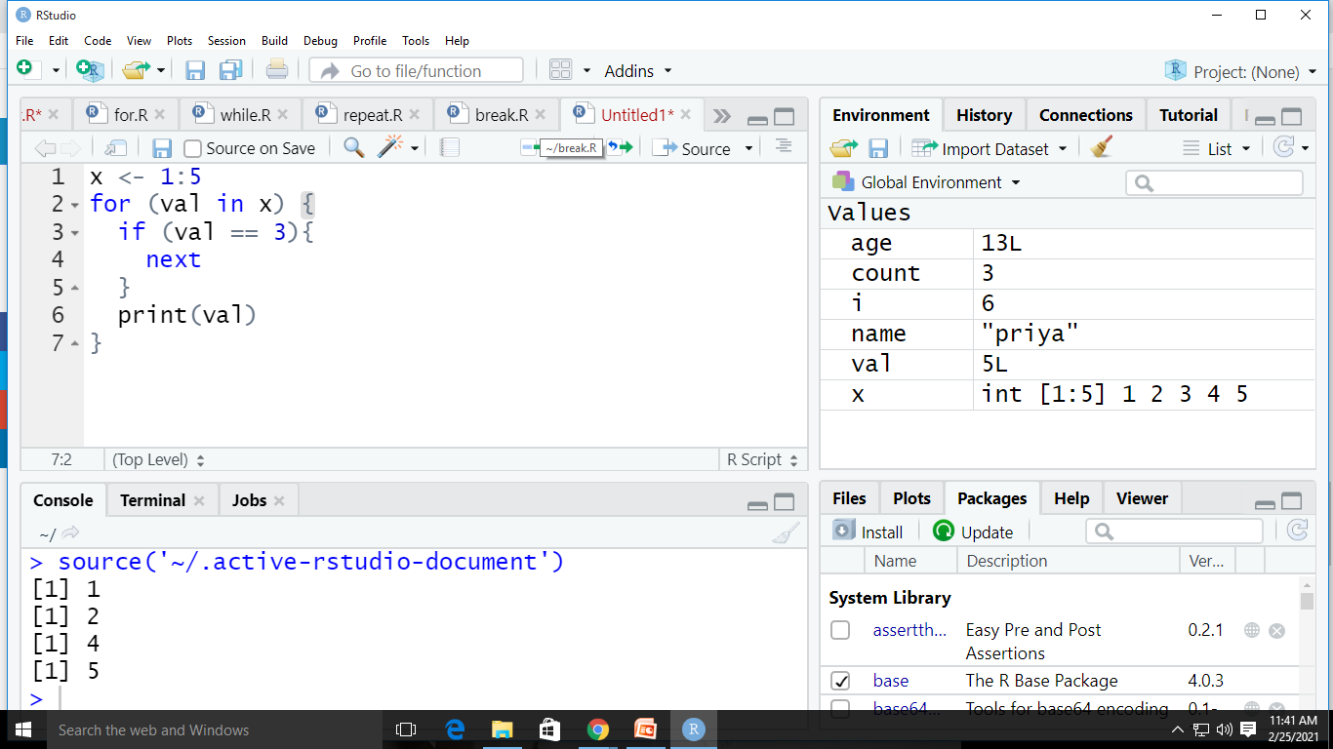
Next
Example
Syntax
if (test_condition) { next }

Slide 44
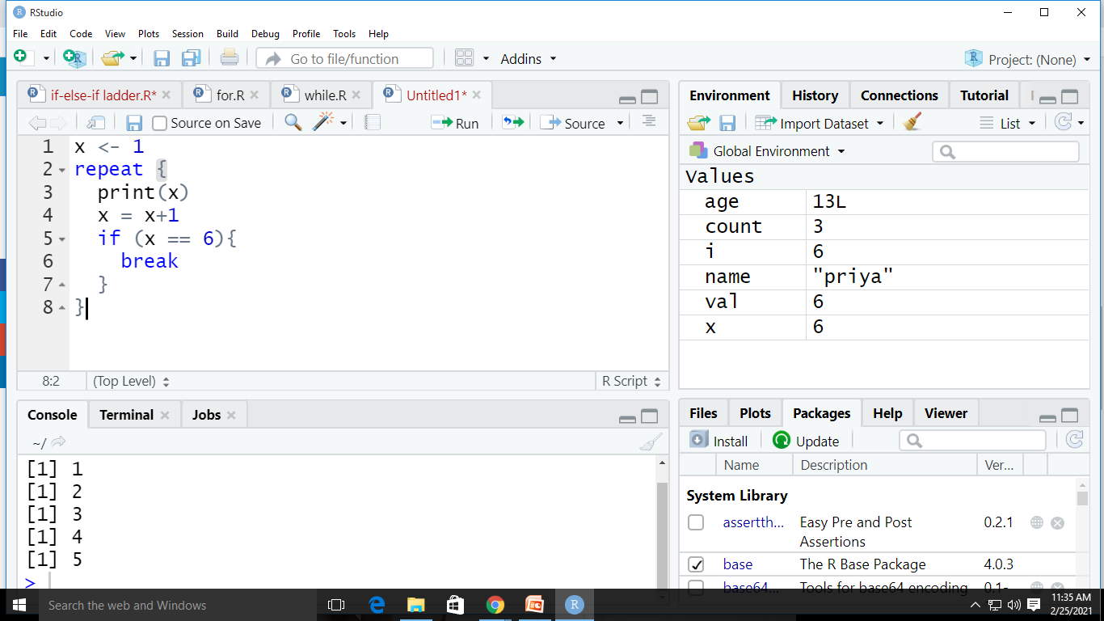
Repeat
Syntax
Example
repeat { statement }

Slide 45
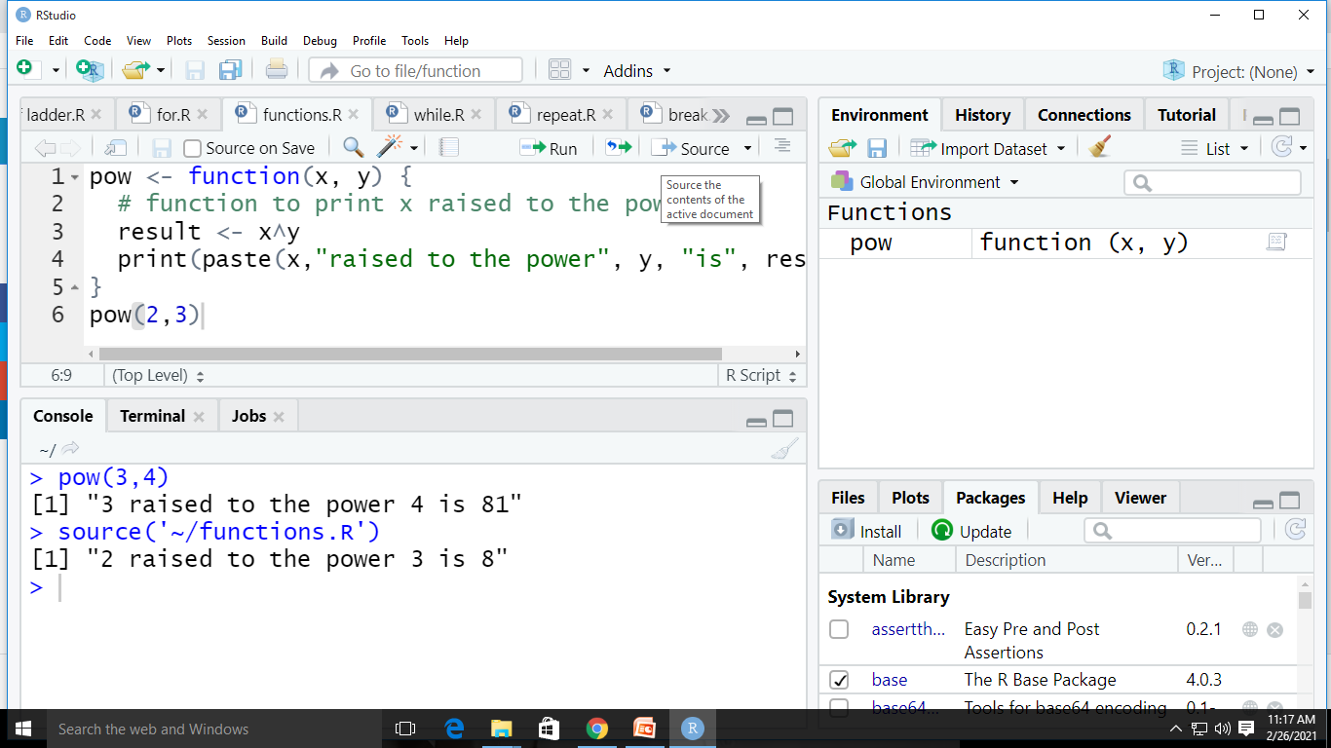
FUNCTIONS USER DEFINED FUNCTION (Functions are used to logically break our code into simpler parts which become easy to maintain and understand)
syntax
EXAMPLE
func_name <- function argument) { statement }

Slide 46
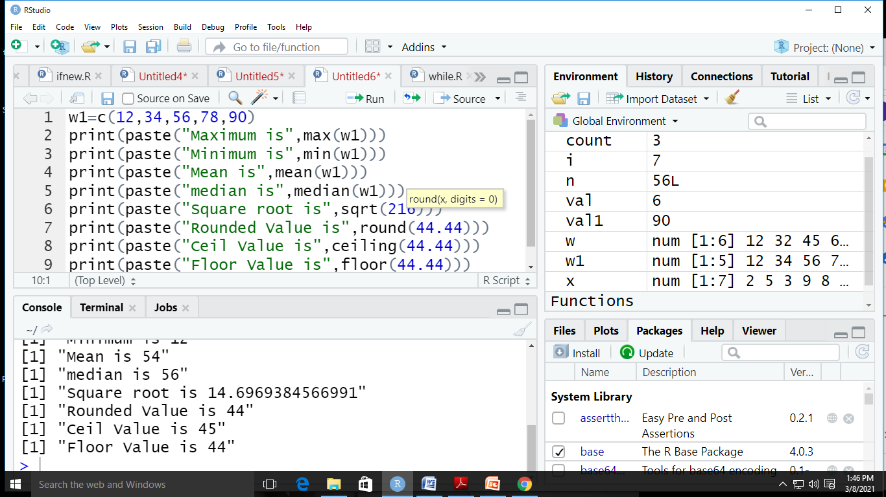
BUILT IN FUNCTIONS
mean()
median()
round()
length()
sqrt()
ceiling()
floor()
max()
min()

Slide 47
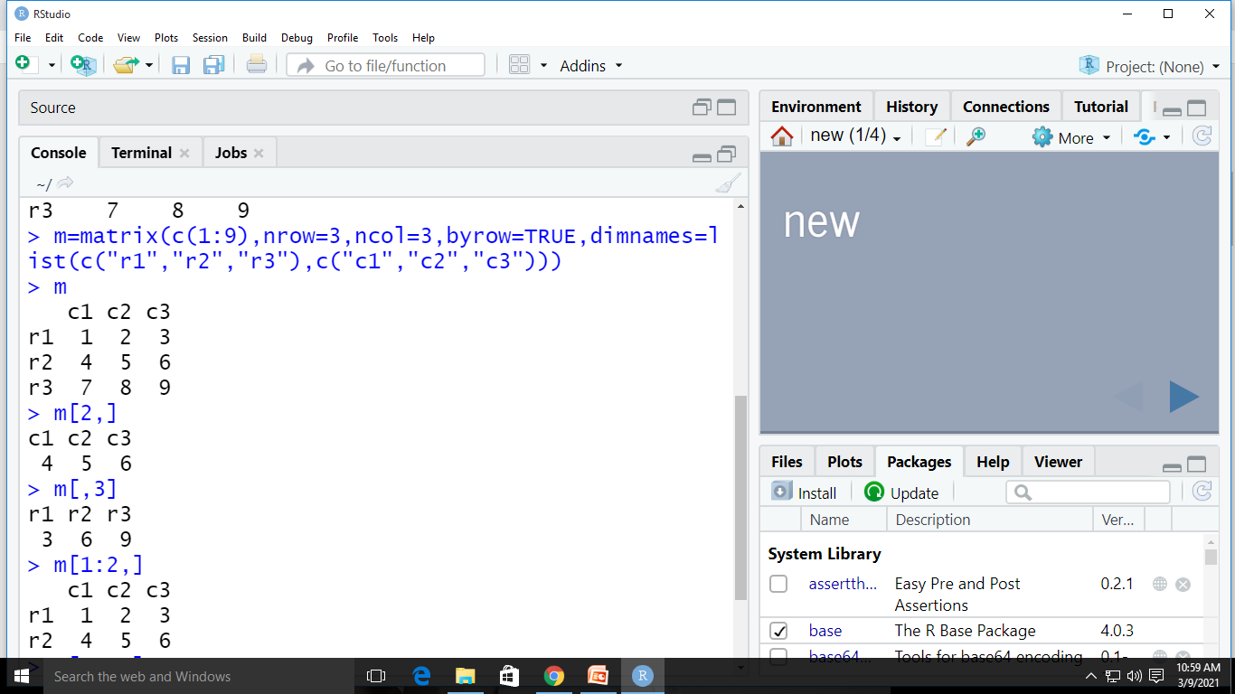
MATRIX

Slide 48
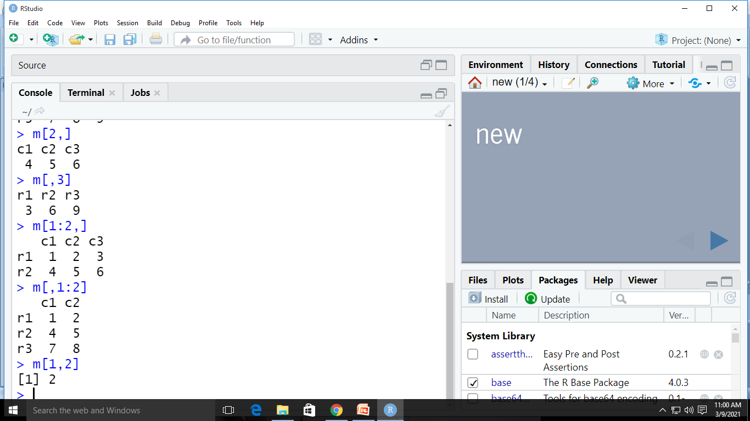
MATRIX

Slide 49
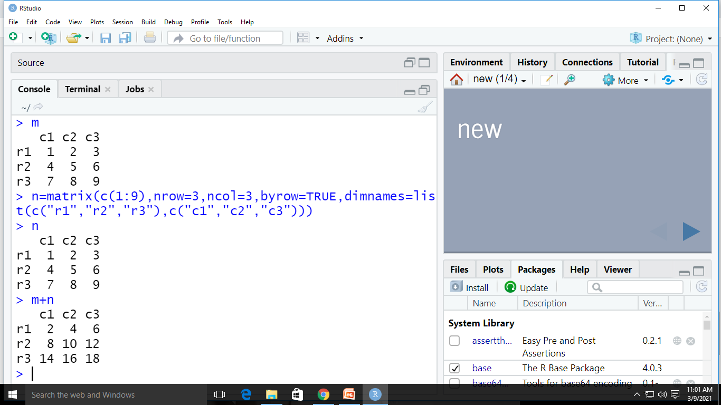
MATRIX ADDITION

Slide 50
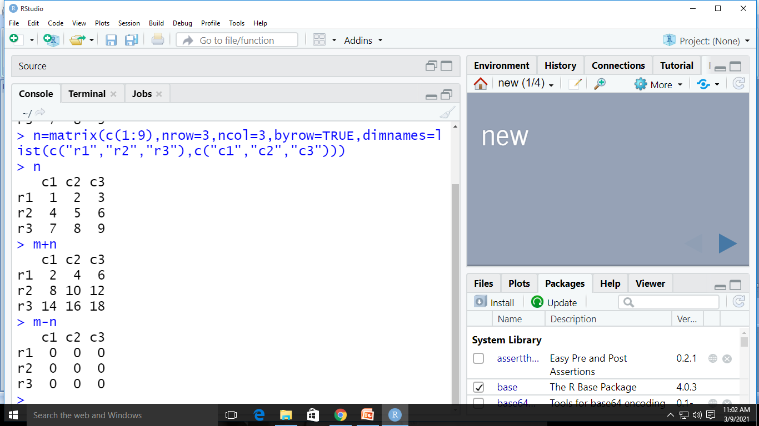
MATRIX SUBTRACTION

Slide 51
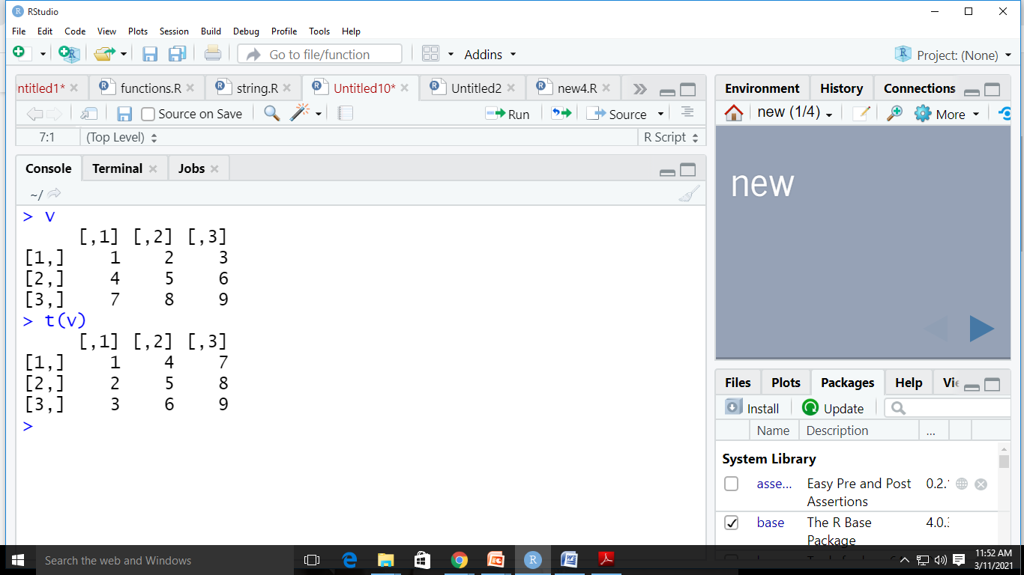
Transpose

Slide 52
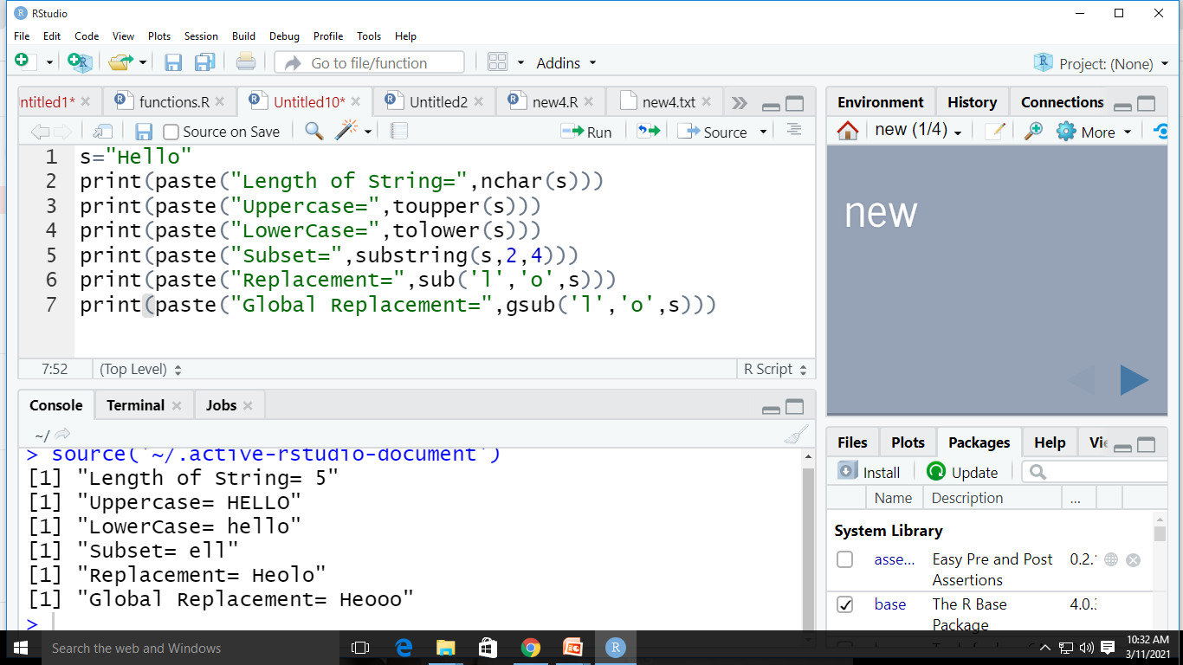
STRINGS

Slide 53
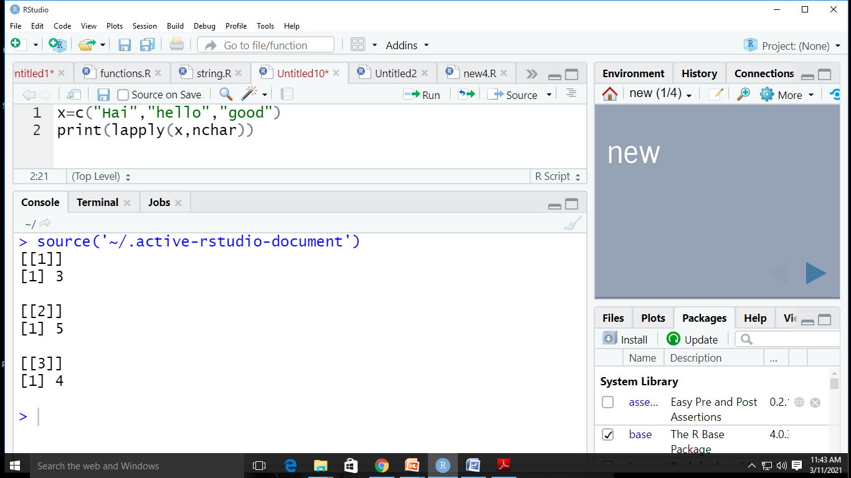
LOOPING FUNCTIONS(lapply())

Slide 54
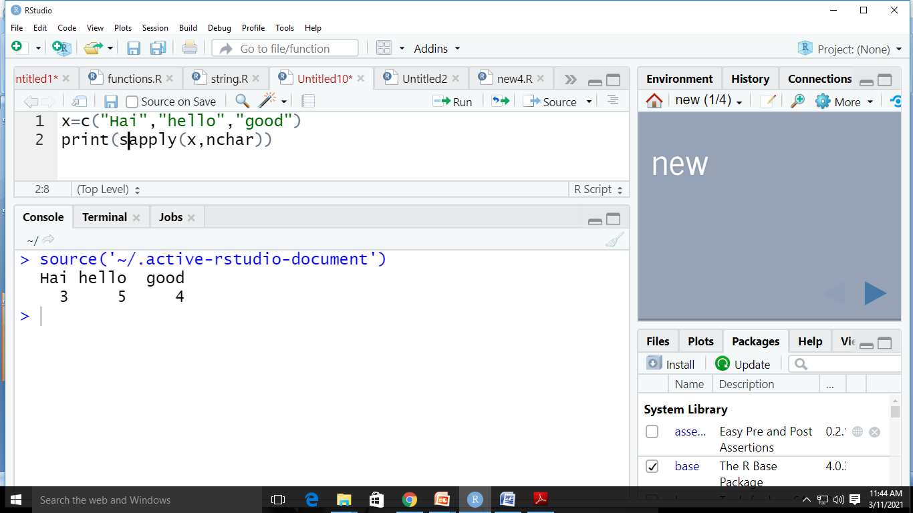
Sapply()

Slide 55
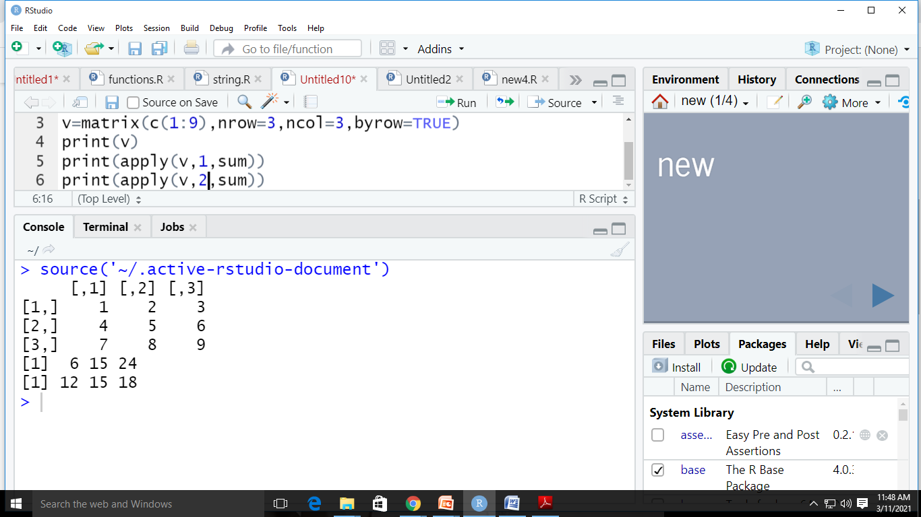
apply()

Slide 56
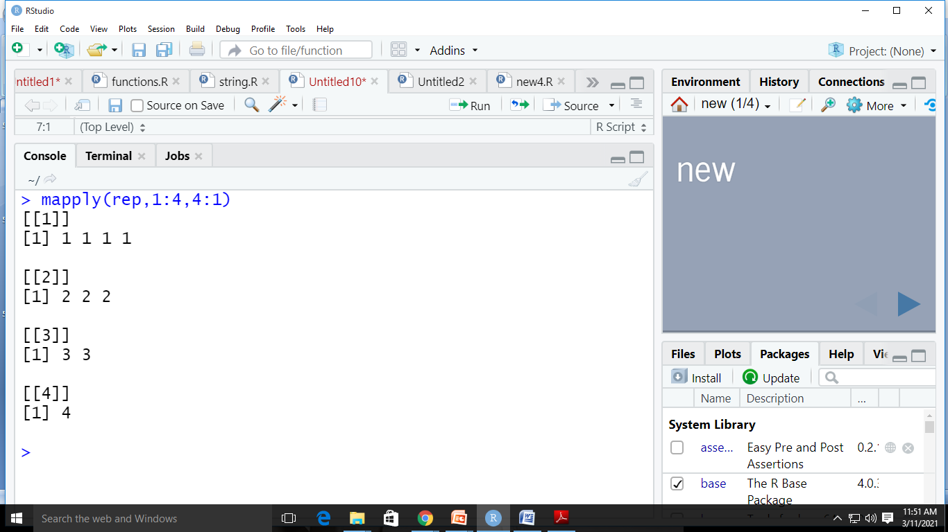
mapply()

